Slide 1
Overview
Our application is place where art lovers can find, discuss, comment, like or dislike art pieces.
The users will be able to display their art where they will receive ratings and comments. The application will provide a guide to the "world of art" for all art enthusiasts.
Art lovers will be able to see prices in a lot of different currencies for their favourite art pieces and contact potential sellers or buyers. Users can feel free to comment on the art or on the price of the art piece and give feedback about the quality of the art.
It will be a place where art lovers feel like they're home.

Slide 2
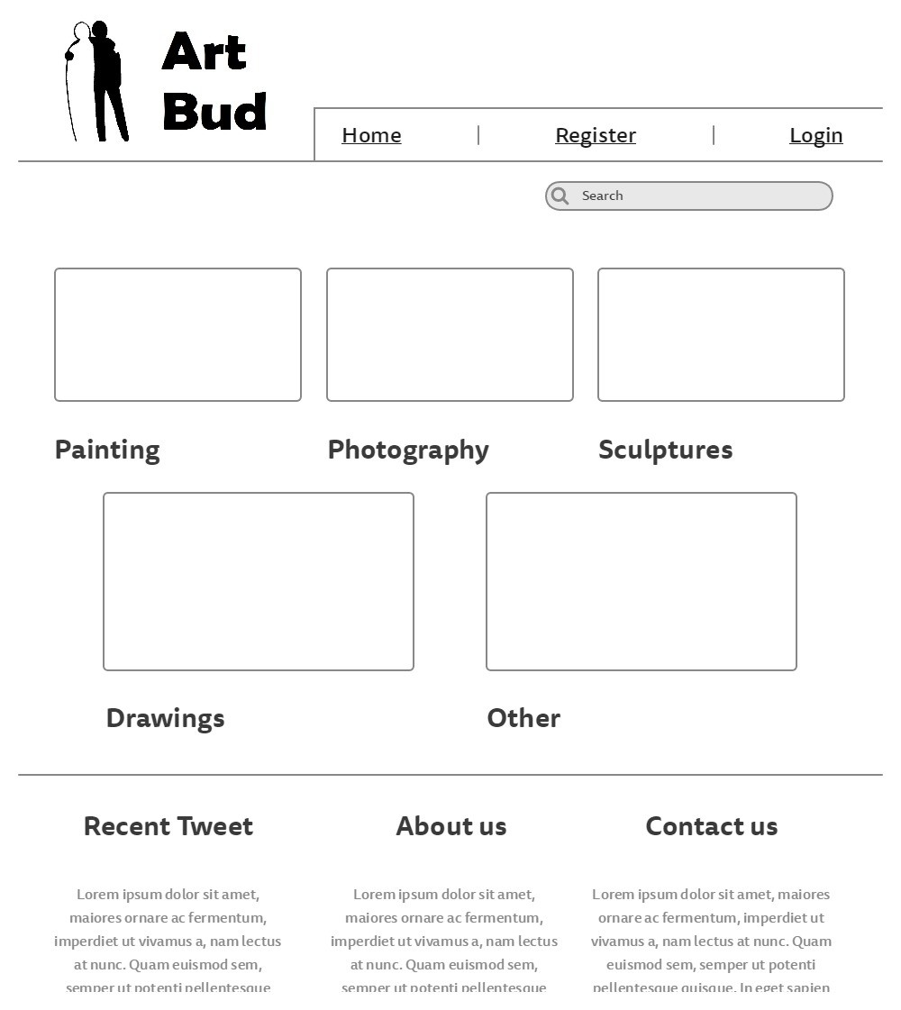

Slide 3
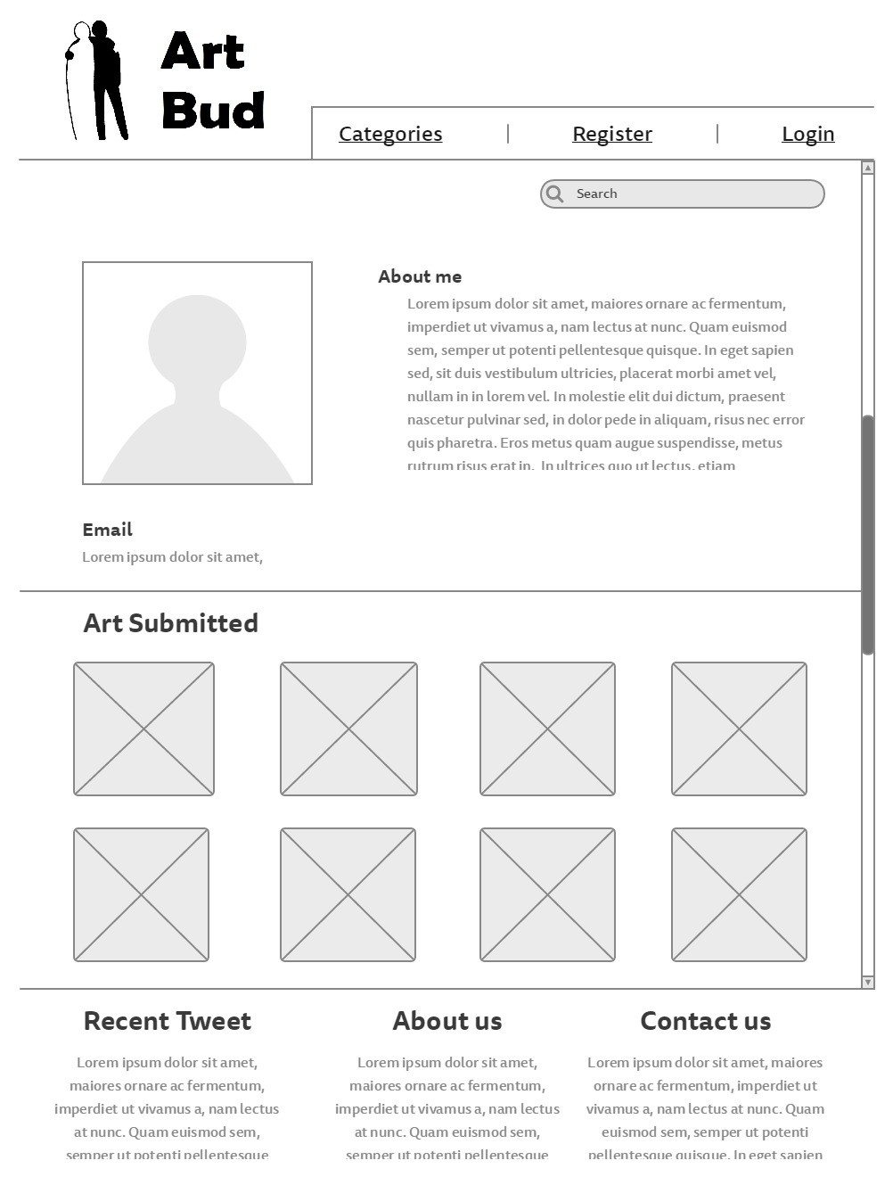

Slide 4
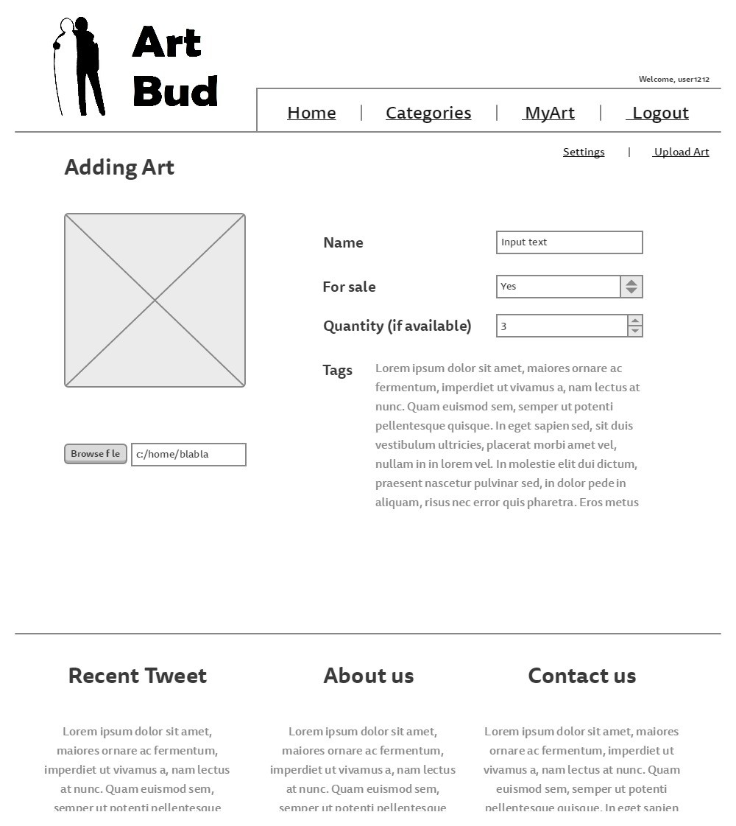

Slide 5
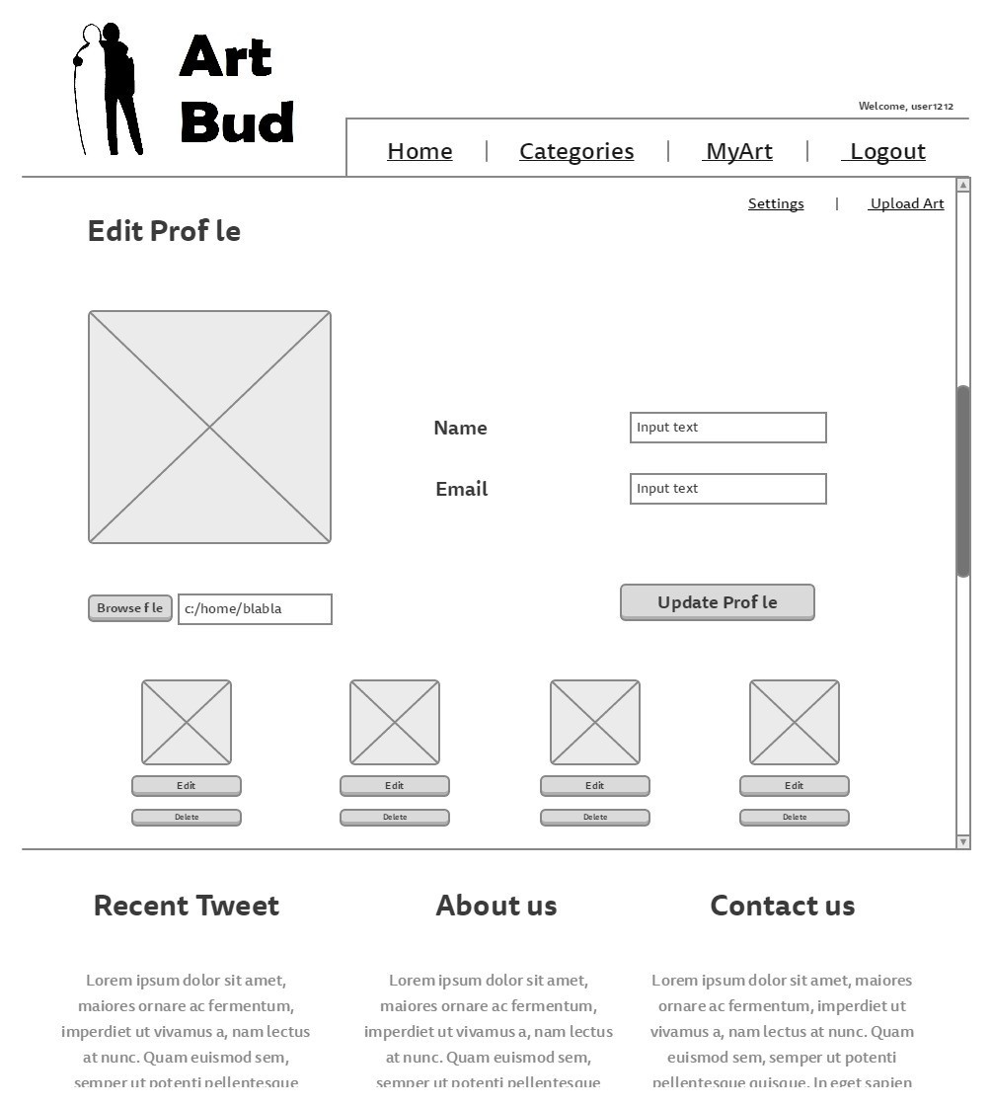

Slide 6
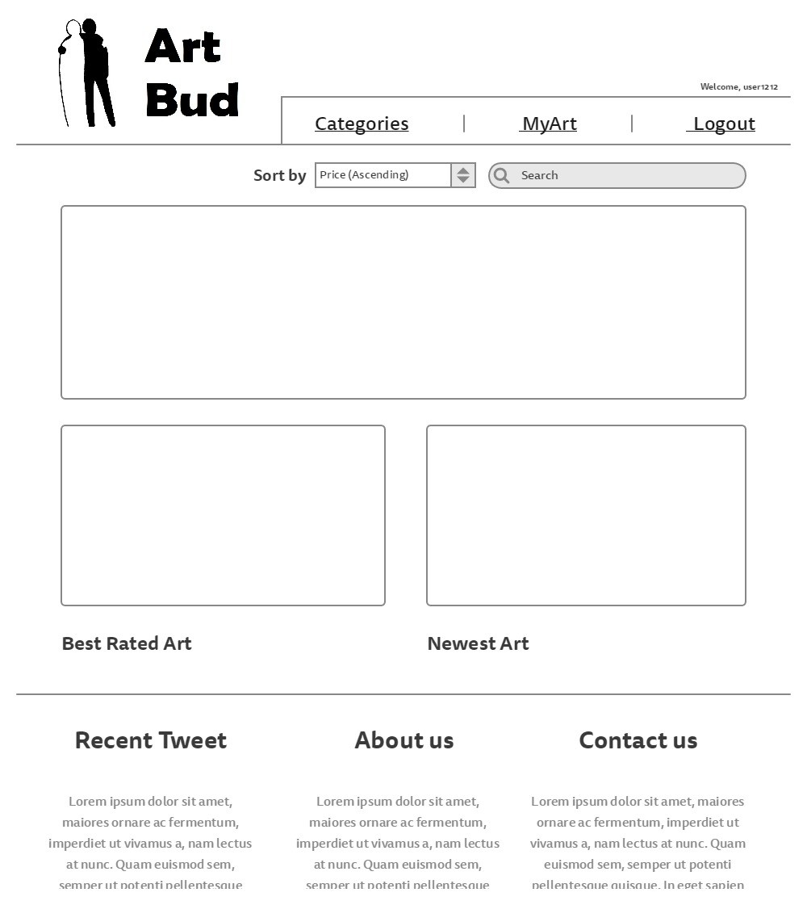

Slide 7
Site URLS
/home
/site-news
/about
/index
/contact-us
/view
/view/{{username}}
/login
/login/myaccount
/login/myaccount/upload
/login/myaccount/settings
/login/myaccount/settings/{{artname}}
/categories
/categories/painting
/categories/photography
/categories/sculptures
/categories/drawings
/categories/other

Slide 8
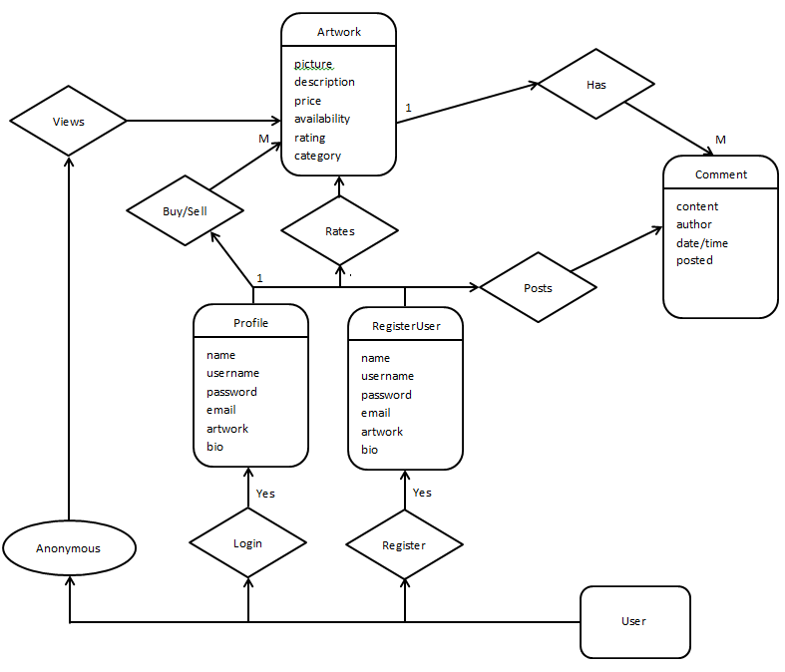
ER Diagram

Slide 9
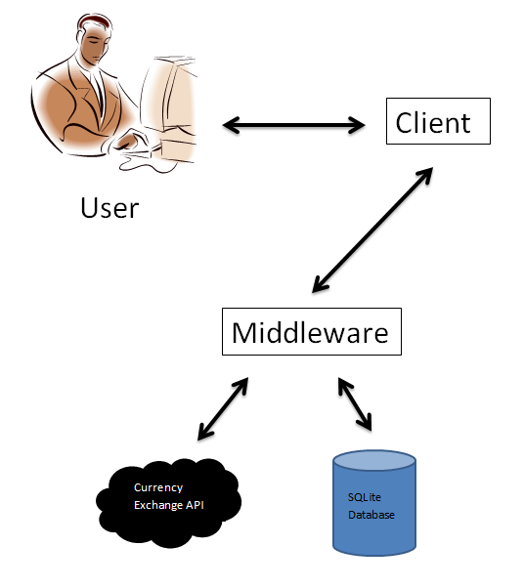
System Architecture

Slide 10
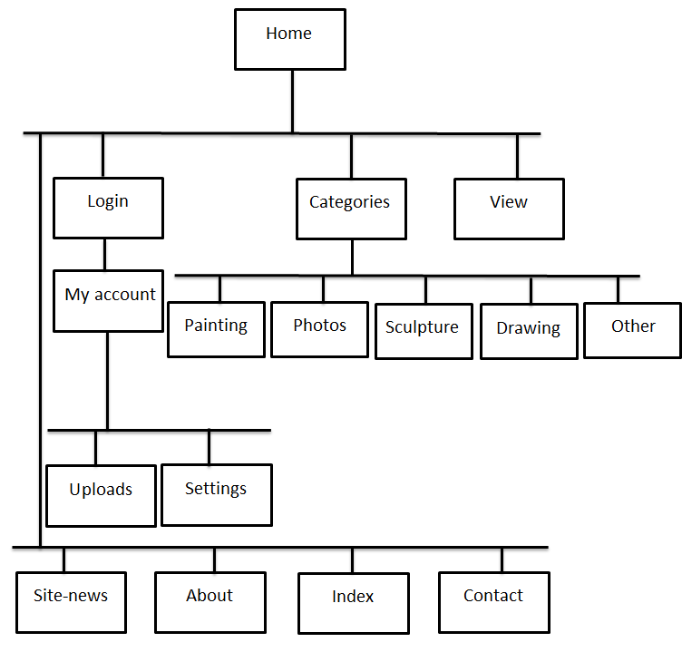
Site Map

